Slide 1
Word embedding
(Kaggle)

Slide 2
Outline
Tokenization
Removing stop words
Lemmatization
One-hot encoding

Slide 3

Tokenization
Convert a sentence (or document) to a list of words (tokens).

Slide 4

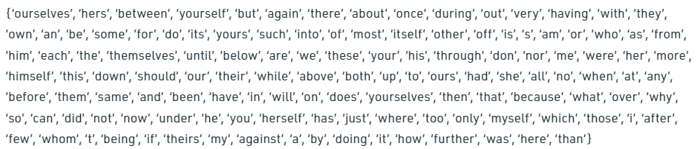
Removing stop words
Stop words are the words provide very less information but often have high occurrence in documents.
NLTK provides a list of words that are commonly considered as stop words.
E.g.:

Slide 5
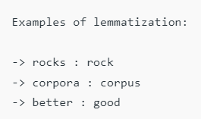

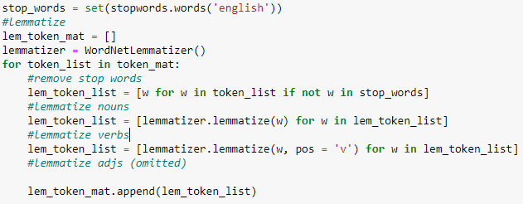
Lemmatization
Lemmatization means converting words to their “original form”.
It reduces the length of the vocabulary and simplifies the data.
NLTK provides a dictionary based lemmatizer.
E.g.:

Slide 6
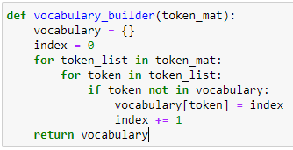


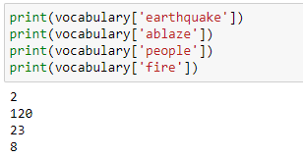
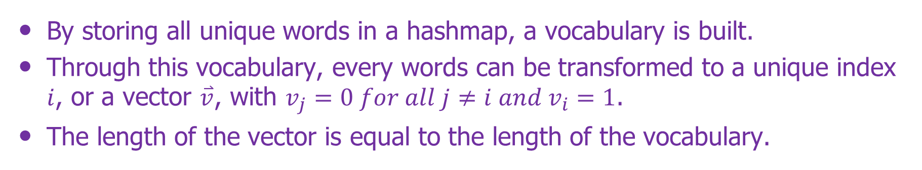
One-hot encoding
By storing all unique words in a hashmap, a vocabulary is built.
Through this vocabulary, every words can be transformed to a unique index $i$, or a vector $\overset{⃑}{v}$, with $v_{j}=0 for all j≠i and v_{i}=1$.
The length of the vector is equal to the length of the vocabulary.
Without stop words removing and lemmatization:
With stop words removing and lemmatization:

Slide 7

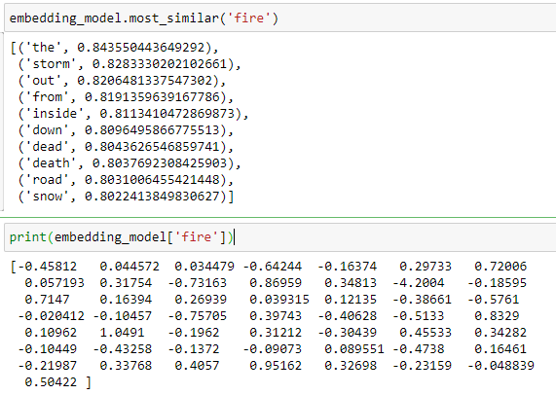
Word2vec model
Use pre-trained model in Gensim to vectorize the text data.
https://github.com/RaRe-Technologies/gensim
https://radimrehurek.com/gensim/models/word2vec.html
GloVe: Global Vectors for Word Representation
Twitter: trained on a dataset from twitter. 2 billion tweets. 27 billion tokens. 1.2 million vocabulary.
50: the resulted embedding is a vector whose length is 50.
The downloaded model is not really a neural network. It is a hashmap called “KeyedVectors”. You can directly get the result embedding vector using the word as the key. It does not compute the embedding vector on the fly, which saves some time.
E.g.:
Pennington, J., Socher, R., & Manning, C. D. (2014, October). Glove: Global vectors for word representation. In Proceedings of the 2014 conference on empirical methods in natural language processing (EMNLP) (pp. 1532-1543).
Get 10 most similar words from the vocabulary based on the similarity among the embedding vectors.
The embedding vector of ‘fire’.

Slide 8
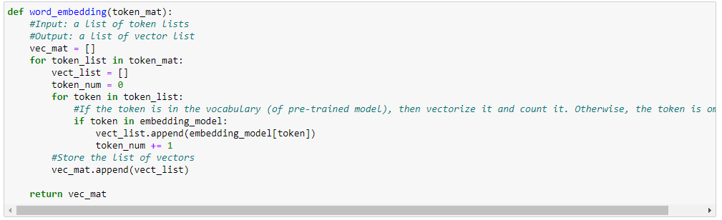
Vectorize the data and store the result

